Slide 1
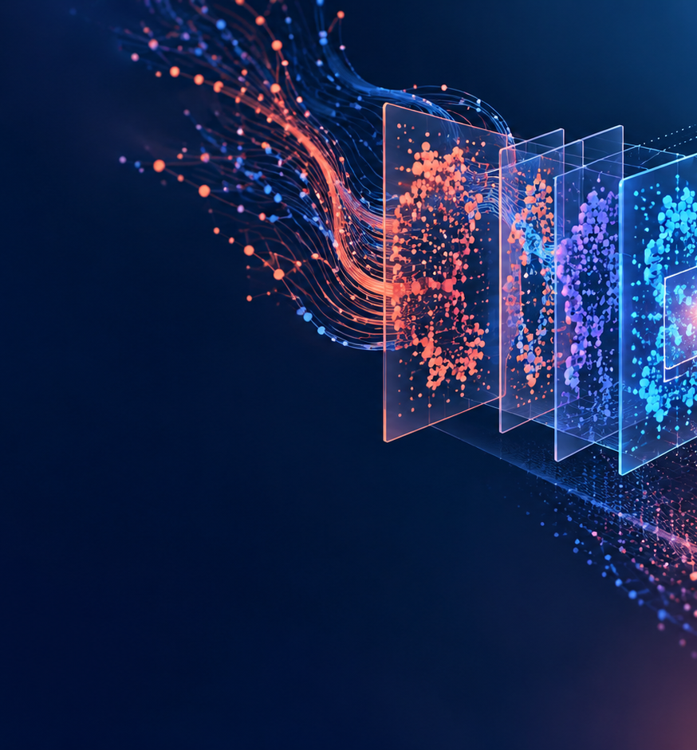
WEEK 2 CONCEPTUAL RETAKE
Introduction to AI
What AI can do, what it cannot do, and who is responsible
Attendance resit presentation
Max Lopez

Slide 2
01 A USEFUL DEFINITION
What AI does
WHAT AI DOES
WHAT PEOPLE ADD
Learns patterns from examples
Makes predictions or rankings
Repeats one narrow task quickly
Understand goals and social context
Decide what is fair or useful
Take responsibility for decisions
AI finds patterns. People decide what the result means and whether to use it.
Max Lopez Attendance resit Week 2
02

Slide 3
02 COMPARATIVE STRENGTHS
Where humans and machines differ
HUMANS ARE STRONGER AT
AI IS STRONGER AT
Understand a student’s unusual situation
Decide what is fair in a difficult case
Adapt after only one new example
Sort thousands of images quickly
Detect patterns in large datasets
Repeat a defined check consistently
For many tasks, people and AI work best together.
Max Lopez Attendance resit Week 2
03

Slide 4
03 SUCCESS AND FAILURE
Three AI successes and three failures
THREE SUCCESSES
WHY THEY WORK
Flood forecasts give earlier warnings
Camera traps sort wildlife images
Satellite data helps detect forest loss
Large, relevant datasets
A clear, narrow task
Results checked by experts
THREE FAILURES
WHY THEY FAIL
Facial recognition led to wrongful arrests
A home-buying model made costly errors
A chatbot invented legal sources
Biased or incomplete data
A changing real-world market
Plausible text without fact checking
Max Lopez Attendance resit Week 2
04
Notes:
Source: https://research.google/blog/a-flood-forecasting-ai-model-trained-and-evaluated-globally/
Source: https://research.google/blog/where-wild-things-roam-identifying-wildlife-with-speciesnet/
Source: https://science.nasa.gov/earth/earth-observatory/faster-detection-of-forest-loss/
Source: https://www.nist.gov/document/innocence-project-comments-nist-sp-1270
Source: https://investors.zillowgroup.com/files/doc_financials/2021/q4/Zillow_4Q-21_Shareholder_Letter.pdf
Source: https://www.thomsonreuters.com/en-us/posts/wp-content/uploads/sites/20/2026/01/Hallucinations-Report-2026_FINAL.pdf

Slide 5
04 CASE STUDY
How AlphaFold helps research
01
02
03
04
Input
Pattern learning
Prediction
Human use
A protein’s amino-acid sequence
Relationships learned from known structures
A proposed three-dimensional structure
Scientists assess, test and apply the hypothesis
Researchers used an AlphaFold prediction to study PINK1, a protein linked to inherited early-onset Parkinson’s disease.
Max Lopez Attendance resit Week 2
05
Notes:
Source: https://www.nature.com/articles/s41586-021-03819-2
Source: https://www.alphafold.ebi.ac.uk/
Source: https://www.ebi.ac.uk/training/online/courses/alphafold/validation-and-impact/how-is-alphafold-used-by-scientists/

Slide 6
05 ACCOUNTABILITY
Who is responsible for a biased hiring system?
Actor
Decision
Responsibility
Key question
Developer
Model and interface
Test limits and report risks
What can fail?
Employer / deployer
Whether and how to use it
Lawful use and human review
Should it decide?
Data team
Training and evaluation data
Representative data and privacy
Who is missing?
Regulator / auditor
Rules and assurance
Independent checks and enforcement
Can harms be challenged?
Max Lopez Attendance resit Week 2
06
Notes:
Source: https://ico.org.uk/about-the-ico/media-centre/news-and-blogs/2024/11/thinking-of-using-ai-to-assist-recruitment-our-key-data-protection-considerations/

Slide 7
06 MY AI-FOR-GOOD IDEA
Smart Waste Sorter idea
NEED
INPUT / OUTPUT
People often hesitate at a bin and contamination reduces recycling quality.
Input: an image. Output: a material category, confidence and disposal guidance.
HUMAN ROLE
SUCCESS
The user can correct uncertain results. Staff review common mistakes.
Less contamination without making disposal slower or excluding users.
Max Lopez Attendance resit Week 2
07

Slide 8
07 LETTER TO MY FUTURE SELF
Letter to my future self
Remember
Protect
Practise
A capable system can still cause harm if it does not fit the situation.
Protect privacy and fairness. Give people a way to challenge a decision.
Test with the people affected and keep a real human alternative.
My commitment: check important results and keep a human alternative.
Max Lopez Attendance resit Week 2
08

